Slide 1
MIS3690 Web Technologies
Babson College
TOIM Division
Fall 2015

Slide 2
Basics of jQuery

Slide 3
What is jQuery?
A library (or collection) of JavaScript functions
Created using JavaScript
Functions that we typically write and pre-created for you
Must know how to refer to and use functions
It is open-source (free for developers and users)
Where is this library?
Can download from : http://jquery.com/download/ and linked as a local file.
Other place to get it: Github
Can also be linked as a remote file (see template for how)

Slide 4
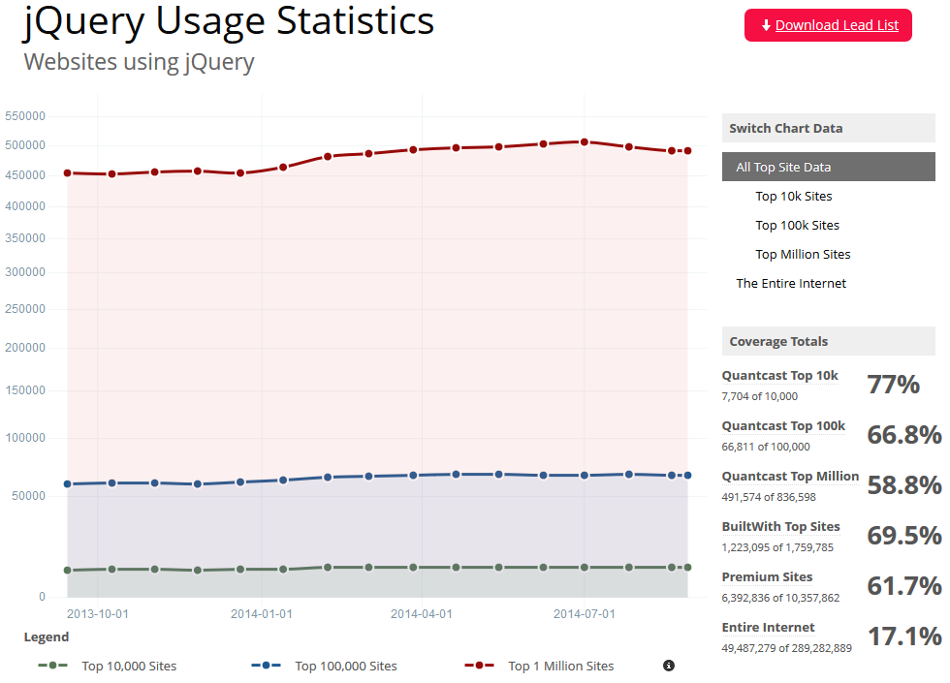

Slide 5
jQuery Syntax
$(selector).action()
action() is a jQuery function
Selector – a HTML tag
Defines the element that triggers the action ()
Also defines the element that is changed/manipulated by the action ()
Examples of selectors:
"h1" – applies the action to all h1 elements
"#one" – applies the action to the element with id="one"
".me" – applies the action to the element with class="me"

Slide 6
jQuery Action examples
Change all <h1> elements to have a Navy font
$("h1").css ("color", "Navy");
Add a border (3px, black, solid) to a paragraph with id "one"
$("p#one").css ("border", "3px solid black");
Change font color and font weight of all elements with the class "fcfw"
#(".fcfw").css ( {"color": "Navy", "font-weight" : "bold"});
Notice the use of the curly parenthesis within the regular parenthesis (only needed when multiple CSS definitions are defined in a single statement).
Notice the difference between the first example (where only one CSS definition was defined) and this example

Slide 7
Defining events with Selectors
$ (Selector).event ( function ()
{
// Actions here
} );
This does not change when you write the actual code
Element that triggers the function
Example: Change the text within a <h1> tag when the <button> element is clicked.
$ ("button").click ( function ()
{
$("h1").text("New Text Here");
});
Element that is changed by the function

Slide 8
Defining events with Selectors
$ (Selector).event ( function ()
{
$(this).action()
} );
Example: Change the text within a <h1> tag when the <h1> element is clicked.
$ ("h1").click ( function ()
{
$(this).text("New Text Here");
});
In this example, we are interacting with an element <h1> and changing the same element <h1> . jQuery uses "this" selector to refer to the same element

Slide 9
A short sample list of Selectors
$("h1") – selects all <h1> elements
$("#one") – selects all elements with id = "one"
$(".two") – selects all elements with class = "two"
$("p#one") – selects all <p> elements with id="one"
$("h1.two") – selects all <h1> elements with class = "two"
$("p:first") – selects the first <p> element
$("ul li:first") – selects the first <li> element under the first <ul> element
$("*") – selects ALL elements on the page (wild card)
$("[href]") – selects all elements with the "href" attribute defined.
$("tr:even") – selects even <tr> elements ("tr:odd" – selects all odd elements)

Slide 10
Sample jQuery Action functions – these come from the library
.hide() – Hide an element on the page
.show() – Unhide an element on the page
.toggle() – Hide/unhide toggle
.fadeIn(speed) – Unhide in slow motion
Speed options: "fast", "slow", # milliseconds
.fadeOut (speed) – Hide in slow motion
Speed options: "fast","slow", # milliseconds
.fadeTo(speed, opacity) – unhide to some extent
Smaller the "opacity" number (between 0 and 1), the more faded it looks
.alert("message") – Same as for JS
.css("property","value") – Apply CSS to an element
Example: css("color","blue")

Slide 11
Next class
More examples on using jQuery.

